Slide 1
Effective Deployment of Teaching Assistants
Fiona Hall @Fionajhalll01
Judith Robson

Slide 2
Starter activity
Complete the audit of your school deployment.
Refer to this throughout the session
Available from: http://maximisingtas.co.uk/services/auditing.php

Slide 3
Background
National Agreement
Inc in TA numbers, creation of Higher Level Teaching Assistants and cover supervisors
TA numbers in the region of 243,000, compared to 451,000 teachers (2014)
around 50,000 HLTAs (2014)

Slide 4
The DISS Project
between 2003 and 2008.
large scale study into the deployment and impact of support staff (DISS) in schools
characteristics of TAs, their training, roles, pay and conditions, and impact they had in classrooms
The study covered primary, secondary and special schools in England
TAs were perceived in a positive light
Examined and questioned: how TAs were deployed
how prepared they were
how effective was their practice
“the more support pupils received, the less progress they made.” (Blatchford et al., 2009 p. 34).
Notes:
Led to follow up project EDTA

Slide 5
Education Endowment Fund
Making Best Use of Teaching Assistants
Overview of recent research including the DISS project
Makes recommendations based on this research
Still drawing heavily from DISS and their follow up work with schools on the Effective Deployment of TAs (EDTA)
Other research reiterates what was found in the DISS project
(Sharples, Webster and Blatchford, 2015)
Notes:
Further work by some of the authors in the same field has been conducted and a very recent report March 2015

Slide 6
The DISS project and EDTA project Findings and recommendations
Preparedness
Deployment
practice
Notes:
Aim of the session: To examine the key findings and recommendations from the DISS project and consider how they relate to your practice and practice in your schools

Slide 7
Preparedness
What do you think the researchers found about TA preparedness?
This means:
How well are TAs trained to support learning including SEN?
How are TAs involved in preparation, planning and feedback with teachers?
Think about your self and the other TAs in your setting.
Place your ideas on a flipchart

Slide 8
Preparedness - what they said
Little training for teachers to work with and/or manage TAs - 75% of teachers no training
Lack of planning, preparation and feedback time with the teacher – 75% teachers had no allocated planning or feedback time (95% secondary
Communication adhoc
Limited subject and pedagogical knowledge
TAs feeling underprepared
Lack of information regarding tasks
(Blatchford, Russell and Webster, 2012)

Slide 9
However – some developments since
ITT does look at TA- teacher collaboration (NQT survey, 2014)
Preparedness of teachers is as important as preparedness of TAs (Russell, Webster and Blatchford, 2013)
TAs report feeling poorly supported by teachers when working with S EN (Vickermann and Blundell, 2012)
TAs often work unsupervised (Warhurst et al., 2014)
School leaders aware of the need to develop the managerial skills of teachers UNISON (2013)
Lack of supervision in the HLTA role (Hancock et al., 2010)
Notes:
Inc number feel prepared to work collaboratively with TAs
UNISON – in relation to TAs

Slide 10
How can schools change?
What can schools do regarding these aspects of preparedness to ensure future research does not tell the same story?
Add to your flip chart

Slide 11
recommendations
Mini tutorials with teachers and TAs
Training on pedagogical strategies
Include in staff training
Training on specific areas of SEN
Qualification and accreditation
Audit of staff skills
Classroom management training
Mentoring schemes
Allocated joint planning and feedback time
Full school inductions – inc shadowing
Notes:
Hand out ???

Slide 12
Changing hours and contracts
Creative timetables
Audit of practice
Teachers to plan lessons for TAs to lead that have the same standards and expectations
Tuning in is beneficial but should not replace appropriate planning and prior discussion of role and task
Appropriate lesson planning with expectations of TAs role clear (inc questioning)
Lesson plans to be shared in advance with TA
(Russell, Webster and Blatchford, 2013)

Slide 13
What do you think?

Slide 14
Deployment
What do you think they said about TA deployment?
This means:
What jobs you are asked to do; what roles you take on?
Place your ideas on the flipchart.

Slide 15
Deployment – what they said
Non pedagogical deployment
Supporting the teacher to carry our routine tasks (prep and org of materials)
Classroom organisation (keeping children on task)
Direct support to children with physical and emotional needs
Pedagogical
Teaching intervention programmes
Teaching individuals, groups and whole classes to support learning
Covering classes
Supporting pupils with SEND and of lower ability
In an informal instructional role supporting pupils with most need

Slide 16
Deployment what they said
The more time spent with TAs the less attention they got from teachers
Withdrawal reduces teacher led learning
These pupils, with more support, make less progress
TAs often ‘velcro’ed to a child
Decisions about contracts and hours of work has a strong influence on how they are deployed AND prepared
(Russell, Webster and Blatchford, 2013)

Slide 17
What can schools do to change?
What can schools do regarding deployment to ensure future research does not tell the same story?
Add to your flipchart.
Notes:
Use a different colour

Slide 18
Recommendations – what they said
Audit TAs in schools
Decide their role – pedagogical or non pedagogical
Audit the interventions and be willing to change frequency, location and duration
Targets to be set for individuals in line with National Curriculum
Ensure teachers take steps to integrate the content of the interventions into class
Ensure TAs feed back from the interventions to the teachers
If TAs lead classes know strengths and limitations and skill set to do the job
Move away for the individual TA model
Notes:
Individual TA model – assigned to pupil

Slide 19
Class, year, subject based TAs – discuss the advantages and disadvantages
Advantages
Disadvantages
Good teacher – TA partnerships
Good understanding of the curriculum
Better knowledge of expected outcomes and assessment
Clear understanding of classroom organisation
Narrower range of subject content needed (Secondary)
More opportunity for joint planning
Making good use of TA skill set
Teachers avoid taking responsibility for some aspects of their role expecting TA to do it
Not explaining to the TA assuming they will know
Lack of coordination of consistency across the school (secondary particularly)
May not have the right TA for the job
Notes:
Handout on partnerships

Slide 20
Further recommendations on conditions and recruitment
Approach future recruitment differently
Raise entry qualifications
Be clear about expected hours of work
Clear job descriptions
Clear person specifications
Review conditions of employment of existing TAs
Train TAs if they do not have the full skill set for the role in which they need to be deployed
Teachers need to consider how TAs can add value to their role and ensure they retain responsibility for the learning of all pupils

Slide 21
What do you think?
Notes:
Final comment – new colour any other ideas

Slide 22
Practice
What do you think the researchers said about TA practice?
Practice means how you interact with learners and encourage learning
Write this on you flipchart

Slide 23
Practice – what they said
More closed questions, fewer open questions
Focus on task completion rather than understanding
Prompts that don’t enhance thinking
Limited feedback to learners that related to their learning
Provide answers
Limited links to prior learning
(Blatchford, Russell and Webster, 2012)

Slide 24
How can schools change?
What can schools do regarding these aspects of practice to ensure future research does not tell the same story?
Write on your flip chart

Slide 25
Recommendations
TA-pupil interactions promote thinking and learning not task completion
TAs to become reflective practitioners
Improve pupil interactions through training, observation and discussion
Create opportunities for learning good practice form others
Develop forms of talk which help pupils to learn independence
Develop pupil led strategies
Improve questioning - plan; use models, wait time
Notes:
TAs and HLTAs are teaching
Model examples given out – Bloom and lanyard kit and also teacher tool kit
Plus activity sheet
Boils down to how you get them to think, how you pass on the information and give them time to think

Slide 26
Recommendations
AVOID
ENCOURAGE
High use of closed questions
Prioritising task completion
Provide the right amount of support at the right time
Pupils to be comfortable with taking risks
Pupils retain responsibility for their learning
Not allowing enough think and response time
Stereo teaching
Giving least amount of help first to aid ownership of task
Over prompting, spoon feeding
Use open questions
Sharples, Webster and Blatchford, 2015
Notes:
Stereo teaching – repeat verbatum what the teacher says

Slide 27
Questioning …

Slide 28
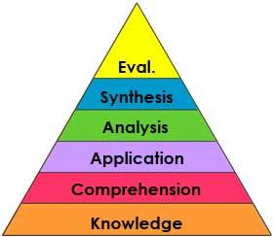
Bloom
Knowledge
Understanding
Application
Analysis
Synthesis
Evaluation

Slide 29
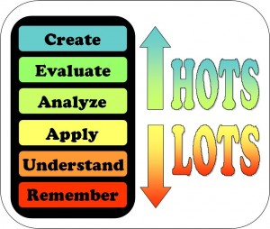
Bloom activity
Hansel and Gretel
Using the Bloom’s pyramid to support your thinking identify the questions as open or closed and where you think they fall on the pyramid. Are they HOTS or LOTS?

Slide 30
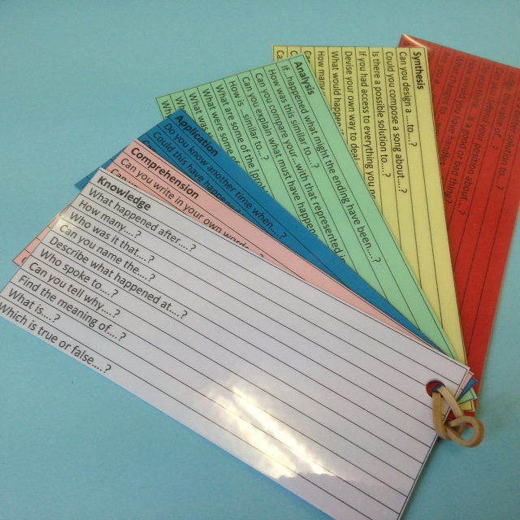
Bloom cards
Question stems to be placed on website

Slide 31
Question matrix
https://belmontteach.wordpress.com/tag/matrix/
Notes:
Suggested by Sharples, Webster and Blatchford - this is a clearer view

Slide 32
In summary
“The impact and practice of TAs need to be seen in terms of decisions made about their deployment, preparedness and their conditions of employment – things that are outside their control”
Russell, Webster and Blatchford (2014) p99
Their key messages:
Preparedness: time to meet
Practice: know when to be quiet, good questions; promote independent learners
Deployment: TAs should work with all ability groups

